Slide 1
Title: Predict House Sale Prices
Author: Hanchao Zhao

Slide 2
Introduction
This project is to build a linear regression model to predict housing prices. The model is trained on a dataset of 100 houses and uses the numeric variables to build the linear regression.
Determin what variables to use
The data set contains two major types of data: numerica and catagorical. This model uses only the numerical data as catagorical data does not suit linear regression.
I will then calculate the correlation of each numerica variable to SalePrice to do another round of filtering.
Linear Regression Design
I will then design a few linear regression solutions using different combination of variables and execute them.
Design Verification
I will then use the different solutions to test against the data to find the one that has the highest score.
Final Test
Finally, I will test the model against the test data.
*Please add slides as required.

Slide 3
The Data
Data is provided by the course instructor.
A 100-row x 82-column table of housing data. Data types are numeric or categorical.
*Please add slides as required.

Slide 4
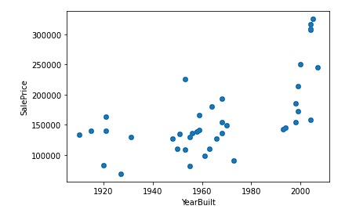
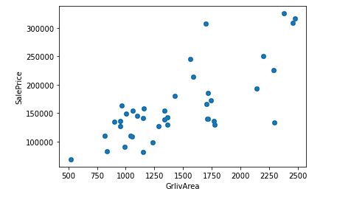
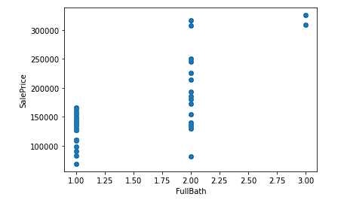
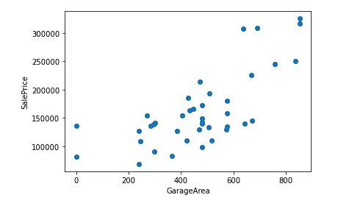
Data Exploration
YearBuilt & SalePrice
GrlivArea & SalePrice
FullBath & SalePrice
GarageArea & SalePrice
*Please add slides as required.

Slide 5
Data Preparation
Select all columns with numeric data.
Compute the correlation of each numeric variables against SalePrice.
List all numeric variables on descending order
Clean the data
Drop columns that have NaN correlation
Fillna missing values with mean
*Please add slides as required.

Slide 6
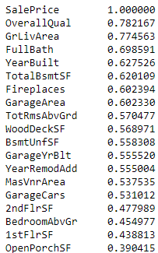
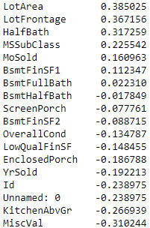
Correlation
Variables that could be used and their correlation with SalePrice:

Slide 7
Project Description
Using Linear Regression to build the model
Instead of just using 20 rows of data, I am going to randomly select 20 rows of data 100 times and concat them into a training data of 2000 rows.
I am going to build four separate trail-models to find the one that works the best:
1. Using all of these selected variables (Control)
2. Using only the top 5 variables that have the highest correlation
3. Using all variables that have over 0.60 of correlation
4. Using all variables that have over 0.55 of correlation
*Please add slides as required.

Slide 8
Analysis and Results
I have built linear regressions based on 4 groups of variables. And the score against the training data of each of these models is shown below:
Model Score of Using Top 5 Variables: 0.832
Model Score of using those who have over 0.55 of correlation: 0.858
Model Score of those who have more than 0.60 of correlation: 0.853
Model Score of all variables: 0.903
allIn model has the highest score. And as a matter of fact, the more variable the model used, the higher the score the model achieved.
The reason of this phenomenon is that, I have already selected the datapoints that have a meanful correlation with SalePrice. As a result, the more of them I use, the more accurate the model.
*Please add slides as required.

Slide 9
Verification
Import the test data
Prep the test data using the same cleaning method
Applied the allIn regression model on to the test data
Result: 0.933
*Please add slides as required.

Slide 10
Conclusion
Conclusion
Data cleaning is critical. All of my prediction model candidates have the score of over 0.80, the highest of which has over 0.90. This is because I have cleaned the data thoroughly prior to the computation.
Sample size and randomlization matter. The total sample size I used in each of the computation was 2000, randomly selected. Which means my sample's representation was very close to the population.
Data quality also matters. The data provided for this exercise has good quality without much missing or NULL data.
*Please add slides as required.

Slide 11
References
"Central Limit Theorem". Boston University Library. https://sphweb.bumc.bu.edu/otlt/mph-modules/bs/bs704_probability/BS704_Probability12.html. Accessed May 13, 2024.
"Multiple Linear Regression". Yale University Library. http://www.stat.yale.edu/Courses/1997-98/101/linmult.htm. Accessed May 13, 2024.
*Please add slides as required.

